Slide 1
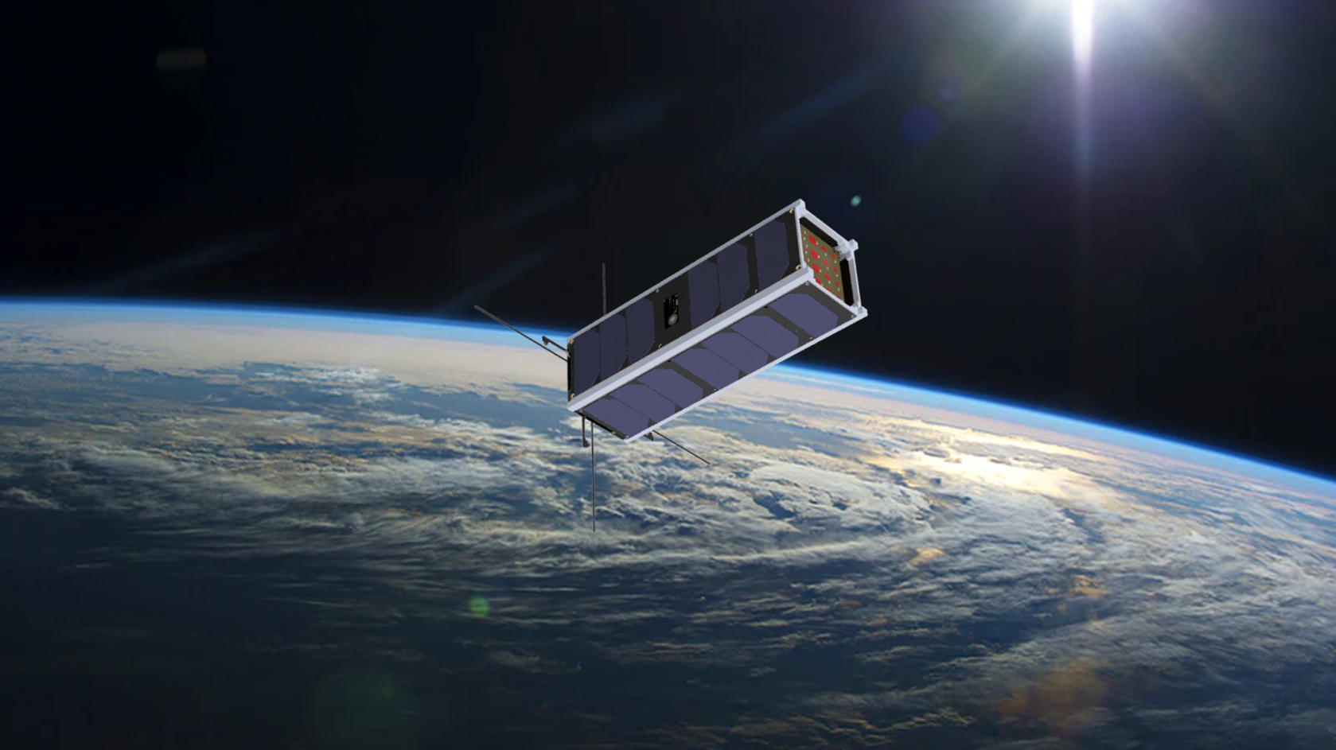



Design and Implementation of Onboard Computer and Communications Architecture for EagleSat-2
Hayden Roszell
NASA Space Grant Symposium
Tempe, AZ
April 22, 2023
Mentor Dr. Ahmed Sulyman
Department of Electrical and Software Engineering
College of Engineering

Slide 2

Overview
EagleSat-2 is a 3U CubeSat being developed by students at Embry-Riddle.
EagleSat Org – team of 60
Scheduled for handover in December of 2023, and launch in Q1 2024
Satellite supports two scientific missions
Memory Degradation Experiment
Cosmic Ray Payload

Slide 3
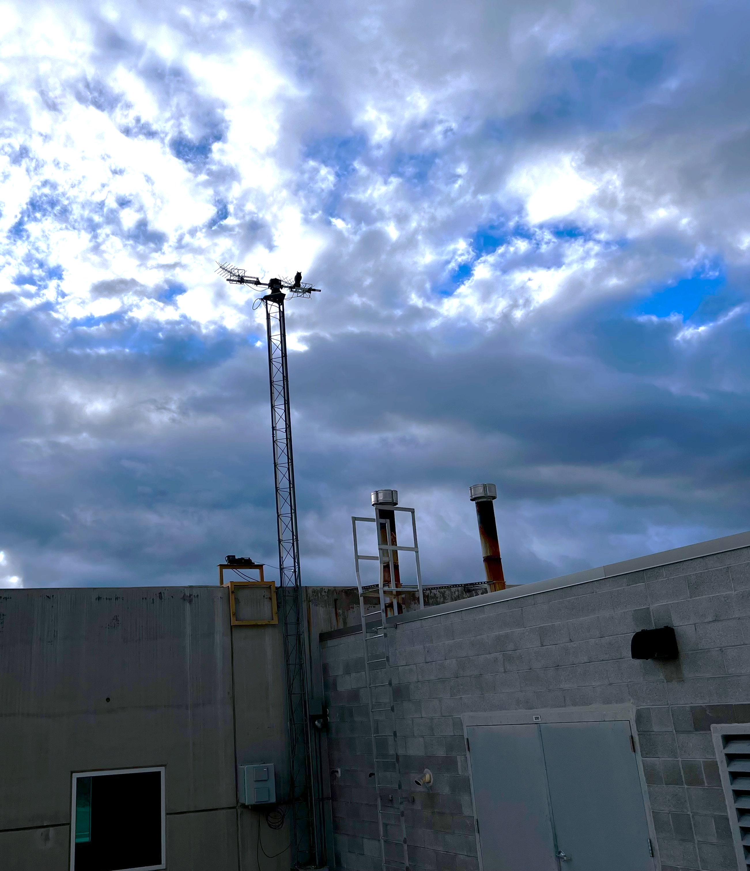
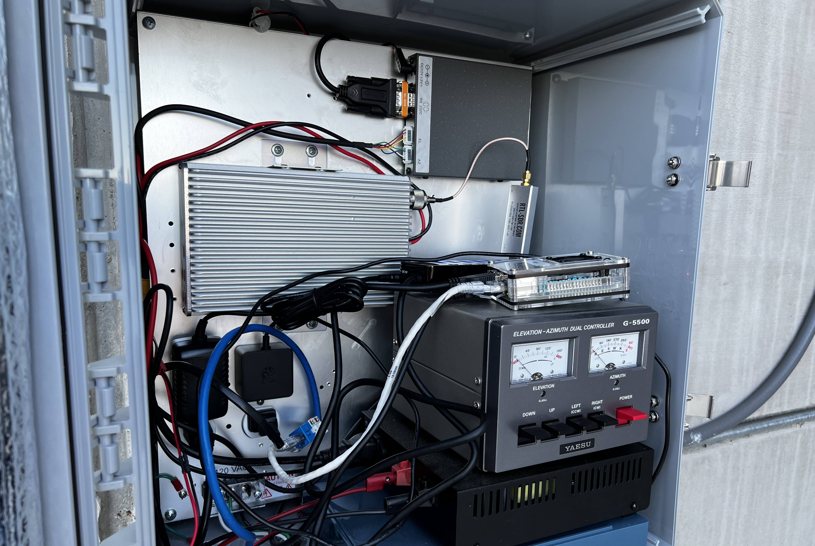
A ground segment was designed and constructed to support EagleSat-2 in orbit.
UHF Antennas
and Rotator
UHF Amplifier & LNA
Rotator Computer
SatNogs
Transceiver
Ground Station
Packet Computer
Headless Ground
Station Box

Slide 4
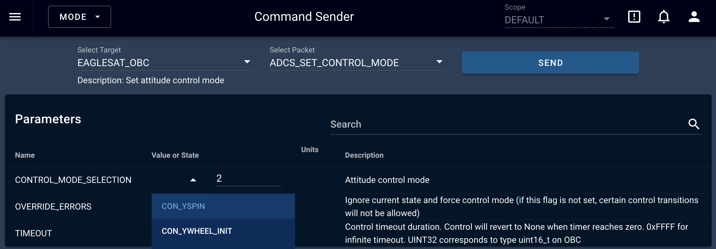
The ground segment uses open-source command and control software, with custom EagleSat-2 plugins.
Command
selector
Command
arguments
Self-documenting
to help operators

Slide 5
Communication with EagleSat-2 is handled with two Layer-2 protocols.
1
EagleSat Telemetry and Telecommand (ESTTC)
Header | Method | Address | Command ID | Data | 32-bit CRC
ES+ | [R/W] | [11,18,22,32,57] | [0-255] | <data> | 0x12345678
ES+W22003320\r
ESTTC is used for all C2 commands to
the satellite. The possible commands
and their arguments are not public.
Read and Write
methods
5 different
addresses
256 commands per
address
Up to 4096-byte
payload
2
AX.25
AX.25 is used for EagleSat-2’s telemetry
beacon readable by all SatNogs ground stations.

Slide 6
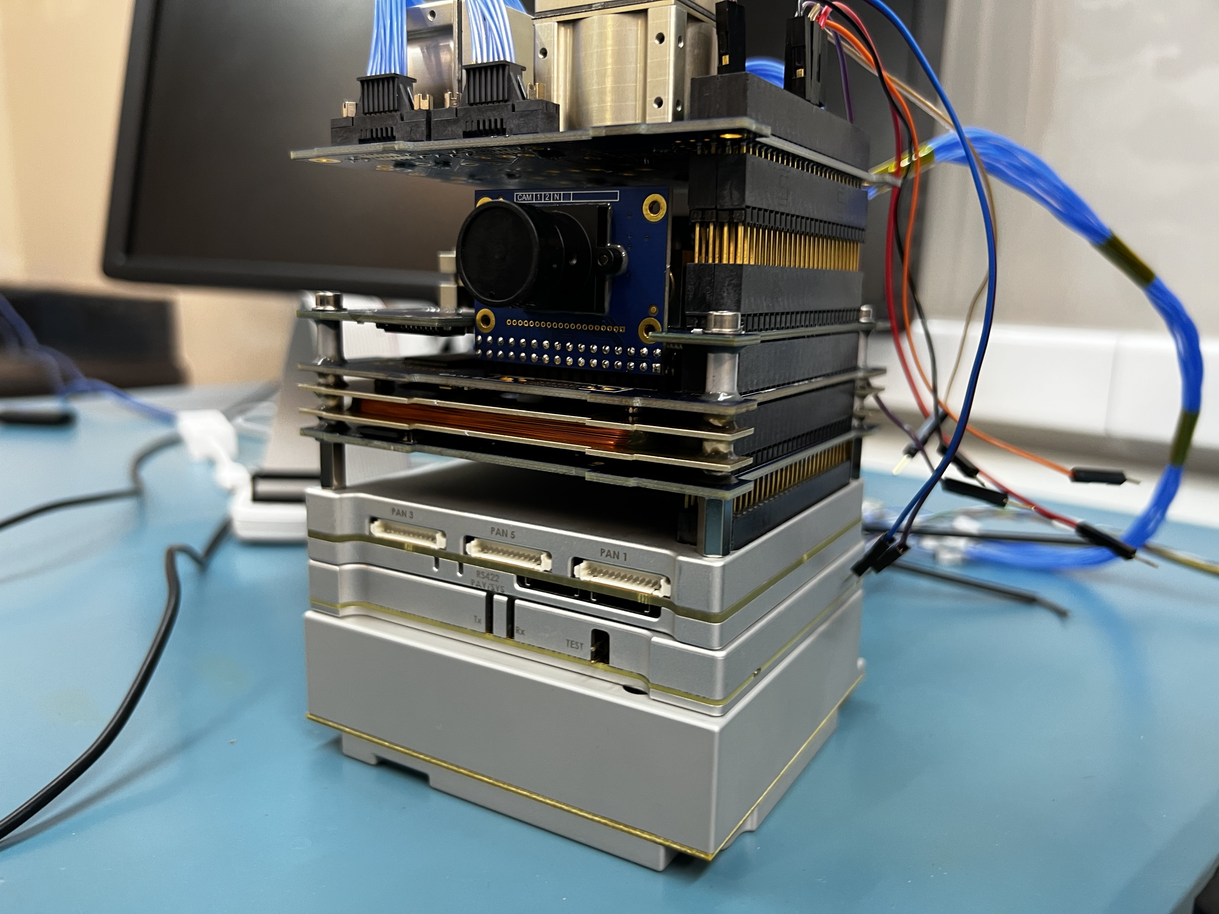
There are five sub-system modules that operate EagleSat-2.
Attitude Determination and
Control System (ADCS)
On-Board
Computer (OBC)
UHF Transceiver
Electrical Power
System (EPS)

Slide 7



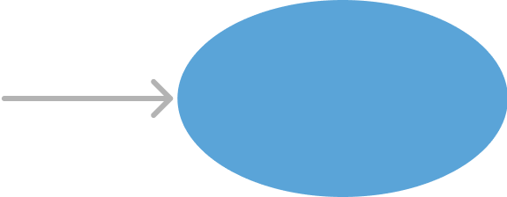


From the perspective of the OBC, there are four components that drive the operation of a subsystem module.
Invokes state
managers periodically
Implemented for each module
Application
Layer
Peripheral Driver
Code Library
Serial Comm.
Interface
State Manager
Scheduler/Real-Time Operating System
Shared
OBC Hardware (32-bit microcontroller)

Slide 8
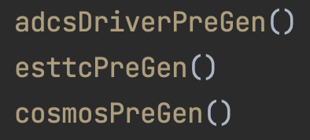
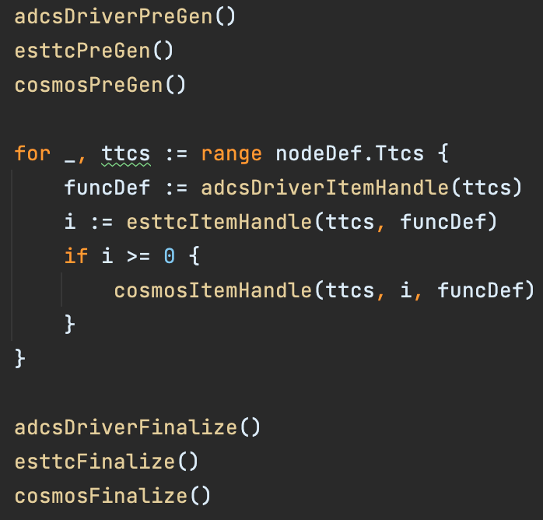
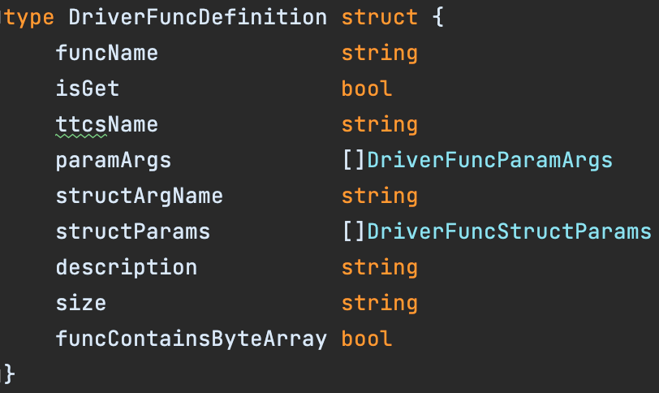
Writing these drivers is tedious, with each being several thousand lines plus abstraction for ground comm.
Then, a pre-generation step
prepares three driver layers
First, interface definitions
are read in XML format
Next, each
definition is
processed one
at a time
Our solution: code generators.
At the end,
generation files
are created
and closed
Internal structures map how data is
handled for each operation
(code generators written in GoLang)

Slide 9
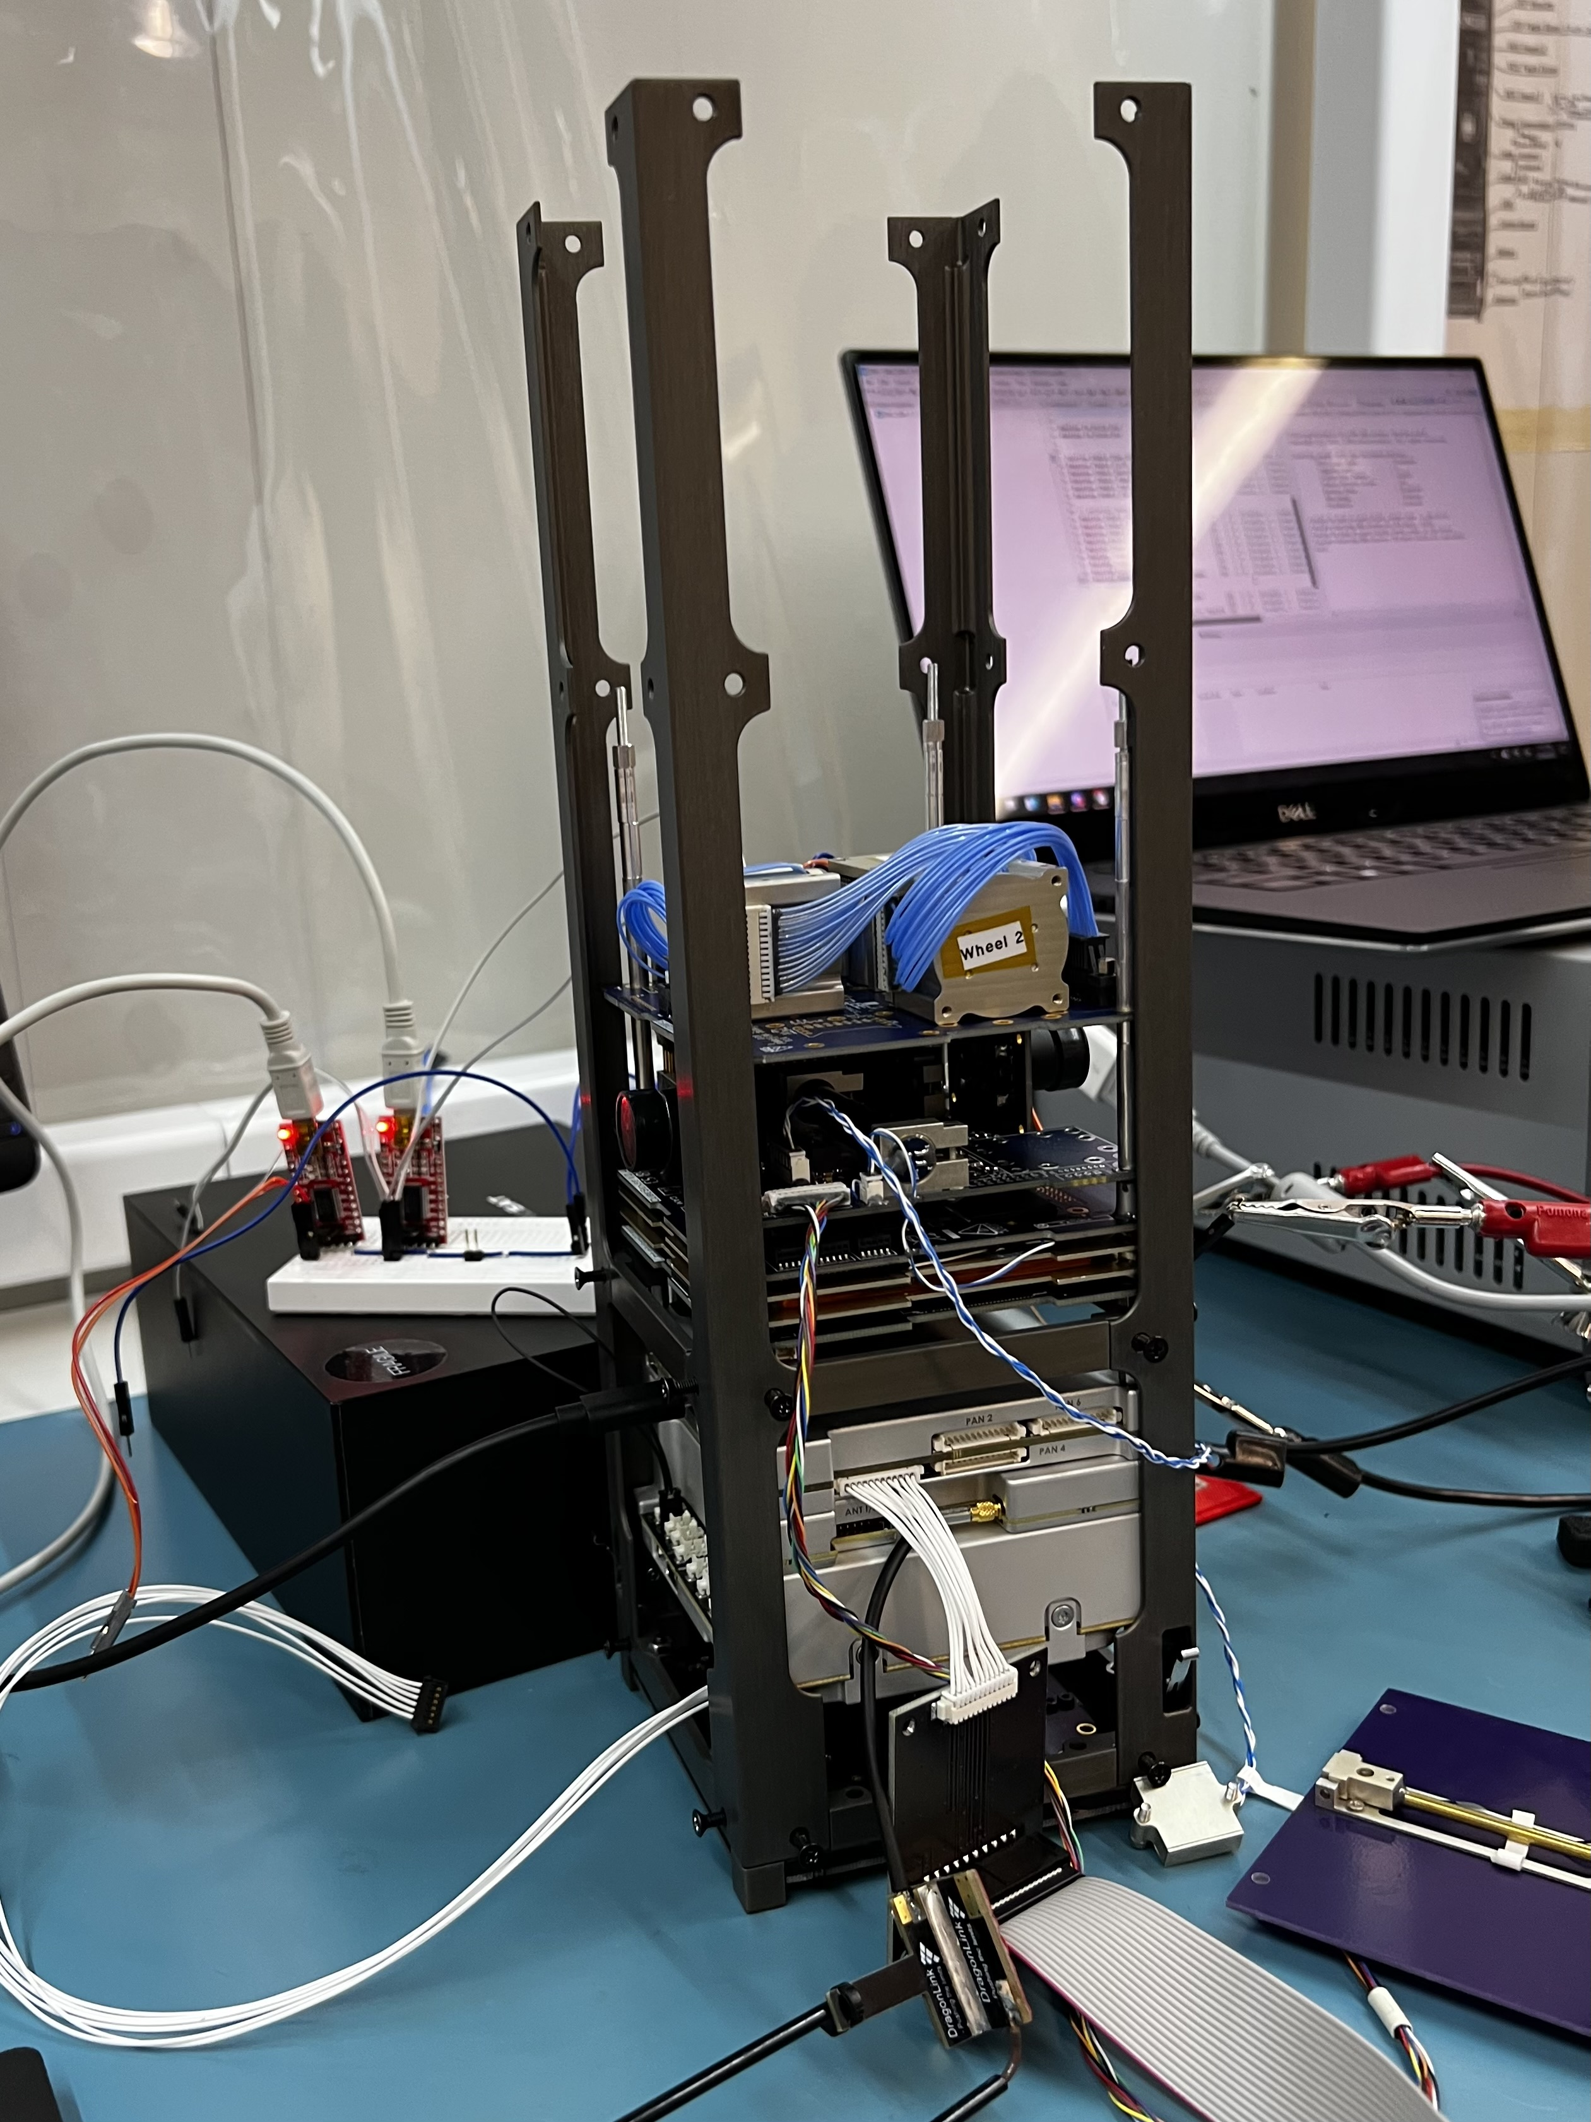

Conclusion
The ground segment and satellite should be tightly integrated systems
Wherever possible, open-source software should be used to reduce design overhead
Clear abstraction layers make integration and testing easier
Auto generating large code libraries reduces the probability of errors and speeds up development
Questions?

